Slide 1
Causal Inference
AI in Science Summer Academy - MIDAS 2023
Bernardo Modenesi

Slide 2

About me
👨 https://sites.google.com/view/bmodenesi
✉️ bmodene@umich.edu
Nationality: I am from 🇧🇷
Education:
Masters Degree in Economics (FGV-EESP + UofM)
Ph.D. in Economics w/ joint degree in Statistics (UofM)
Current position:
MIDAS Data Science Fellow
Topics of interest:
Causal Inference & AI
Ethical AI methods
Labor Economics
Network Theory

Slide 3
Today Not today
Rubin Causal Inference (CI)
Potential Outcomes
Treatment Effects
Analysis of several Causal Inference statistical models and their assumptions, with hands-on applications
Machine Learning and CI
Pearl’s Causal Inference
Directed Acyclic Graphs (DAGs) and do(.) calculus
Often parametric, creating biases
Causal Discovery
e.g. Granger Causality

Slide 4
Outline
Basic framework
Motivation
Potential Outcomes
(some) Parameters of interest
The golden standard: Randomized Experiments (RCT)
When randomization isn’t an option
Selection on observables
Instrumental Variables (IV)
Matching
Difference-in-differences (DiD)
Panel Data and Fixed Effects
Synthetic Control
Regression Discontinuity Design
Machine learning and Causal Inference
Aiding the development of new theories

Slide 5
Outline
Basic framework
Motivation
Potential Outcomes
(some) Parameters of interest
The golden standard: Randomized Experiments (RCT)
When randomization isn’t an option
Selection on observables
Instrumental Variables (IV)
Matching
Difference-in-differences (DiD)
Panel Data and Fixed Effects
Synthetic Control
Regression Discontinuity Design
Machine learning and Causal Inference
Aiding the development of new theories

Slide 6
A different focus
Basic framework
Most of Machine Learning models are interested in powerful predictive models.
Even more generally in statistics, we also optimize the bias vs variance trade off by minimizing MSE, in order to estimate parameters that fits the data well.
In Causal Inference, on the other hand, we do not trade less variance for more bias. Instead, we build models that are zero biased (at least asymptotically), in order to make inference regarding causal/structural relationships about the world, avoiding capturing spurious relationships in the data.

Slide 7
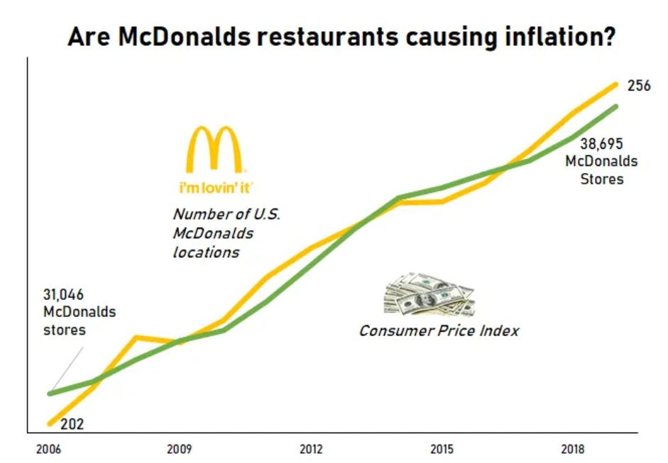
Correlation vs Causation
Basic framework
Some correlations do not imply causation
Hidden variable/confounder: Economic growth?

Slide 8
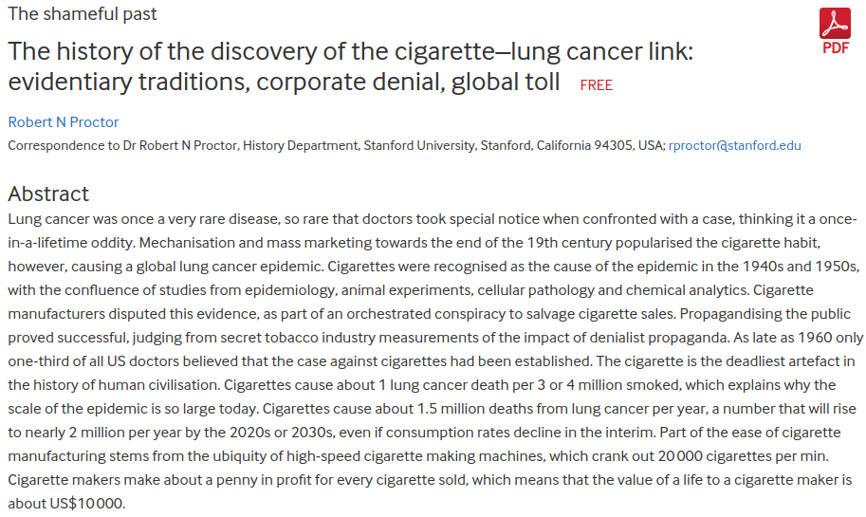
Correlation vs Causation
Basic framework
Other correlations do

Slide 9
A different focus to answer different questions
Basic framework
What is the effect of air pollution on the likelihood of developing lung cancer?
Is a new vaccine better than placebo? By how much?
What is the impact of sleep quality in academic performance?
What is the impact of a college degree on income?
By how much a specific marketing campaign could increase sales?

Slide 10
Questions regarding comparing states of the world
Basic framework
What is the effect of air pollution on the likelihood of developing lung cancer?
Polluted air 🇽 Clean air
Is a new vaccine better than placebo? By how much?
Placebo vaccine 🇽 Vaccine w/ medication
What is the impact of sleep quality in academic performance?
Poor sleep quality 🇽 Good sleep quality
What is the impact of a college degree on income?
High School degree🇽 College degree
By how much a specific marketing campaign could increase sales?
No campaign 🇽 Marketing campaign
NOTE: The set of states doesn’t need to be only binary!
Change the state of the world, while keeping everything else constant, i.e. ceteris paribus.

Slide 11
Applications
Basic framework
Widely used in:
Computer Science, Biostatistics, Medicine, Economics, Policy, etc.
Could be more explored in:
Engineering and other ‘hard sciences’:
oil industry (e.g. microseismic data analysis and fracture monitoring)
Aiding Explainable AI (XAI)
Potentially powerful tool with AI models
AI models capture complex non-linearities, which can generate hypothesis for theory making, confirmed by employing experiments and Causal Inference.

Slide 12
Causal Inference in your field?
Basic framework
How about in your field? What are potentially interesting (answered or not) causal inference questions?
Take 5 min for:
Attempting to write at least 3 research questions on your paper sheet.
What are the states involved?
Is there data already collected on it? If not, is there a strategy to gather relevant data to answer your question?
Share your thoughts briefly with your neighbors

Slide 13



Potential Outcomes notation
Basic framework
States of the world under an optional vaccine:
Yi(0)
Notation
T: observed treatment
Y: observed outcome
i : observation index
Yi(0): potential outcome under
no treatment
Yi(1): potential outcome under
treatment
Ti = 0
Ti = 1
Yi(1)

Slide 14
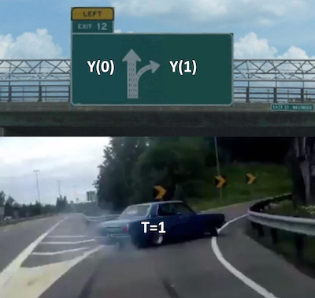
Factual & counterfactual
Basic framework
Fundamental problem of causal inference
(Holland, 1986)
It is impossible to observe both of the potential outcomes for the same unit.
i | Ti | Yi | Yi(1) | Yi(0)
Edith | 1 | 10 | 10 | .
Mary | 1 | 7 | 7 | .
John | 0 | 5 | . | 5
James | 1 | 8 | 8 | .
Elyse | 0 | 4 | . | 4
Treatment effect:

Slide 15
Factual & counterfactual
Basic framework
Fundamental problem of causal inference
(Holland, 1986)
It is impossible to observe both of the potential outcomes for the same unit.
i | Ti | Yi | Yi(1) | Yi(0) | θi
Edith | 1 | 10 | 10 | . | ?
Mary | 1 | 7 | 7 | . | ?
John | 0 | 5 | . | 5 | ?
James | 1 | 8 | 8 | . | ?
Elyse | 0 | 4 | . | 4 | ?
Treatment effect:

Slide 16
Factual & counterfactual
Basic framework
i | Ti | Yi | Yi(1) | Yi(0) | θi
Edith | 1 | 10 | 10 | . | ?
Mary | 1 | 7 | 7 | . | ?
John | 0 | 5 | . | 5 | ?
James | 1 | 8 | 8 | . | ?
Elyse | 0 | 4 | . | 4 | ?
I particularly see most of the inference models as solving a potential outcomes missing data problem, with each model imposing different assumptions depending on the nature of the data.
Estimating individual treatment effects is possible, but it would require a lot of assumptions.
Typically we estimate average treatment effects.
Treatment effect:

Slide 17
(some) Parameters of interest
Basic framework
Average Treatment Effect
i | Ti | Yi | Yi(1) | Yi(0) | θi
Edith | 1 | 10 | 10 | . | ?
Mary | 1 | 7 | 7 | . | ?
John | 0 | 5 | . | 5 | ?
James | 1 | 8 | 8 | . | ?
Elyse | 0 | 4 | . | 4 | ?
Average Treatment Effect for the Untreated
Average Treatment Effect for the Treated
Conditional Average Treatment Effect
Treatment effect:

Slide 18
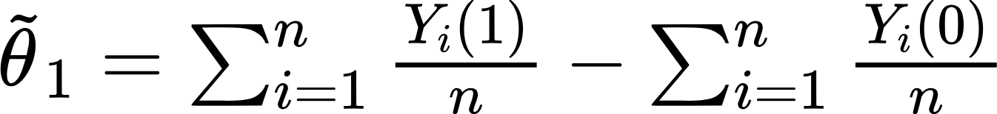
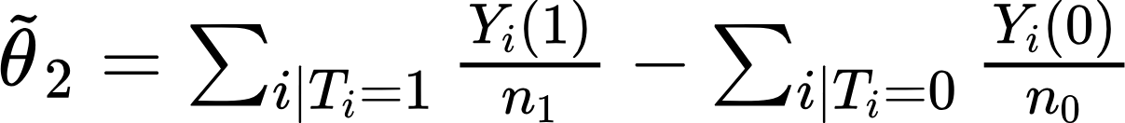
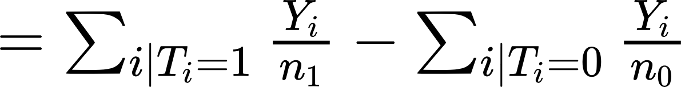
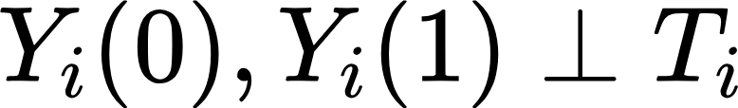
Simple estimation & assumptions
Basic framework
Average Treatment Effect
i | Ti | Yi | Yi(1) | Yi(0) | θi
Edith | 1 | 10 | 10 | . | ?
Mary | 1 | 7 | 7 | . | ?
John | 0 | 5 | . | 5 | ?
James | 1 | 8 | 8 | . | ?
Elyse | 0 | 4 | . | 4 | ?
Using the Method of Moments, is this estimator for θ feasible?
How about the following naive estimator?
Observation rule:
p
p
?

Slide 19
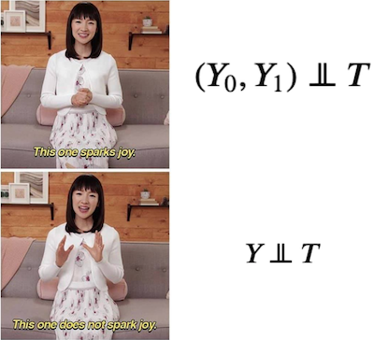
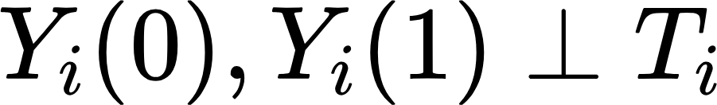

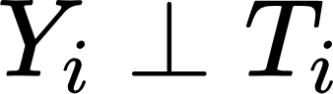
Simple estimation & assumptions
Basic framework
Assumption:
Zero treatment effect

Slide 20
Outline
Basic framework
Motivation
Potential Outcomes
(some) Parameters of interest
The golden standard: Randomized Experiments (RCT)
When randomization isn’t an option
Selection on observables
Instrumental Variables (IV)
Matching
Difference-in-differences (DiD)
Panel Data and Fixed Effects
Synthetic Control
Regression Discontinuity Design
Machine learning and Causal Inference
Aiding the development of new theories

Slide 21
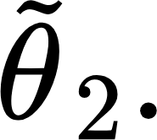
Observational studies
2. RCTs, the golden standard
Danger of observational studies:
Observational studies often measure something proportional to
Hormonal Replacement Therapy (HRT) was once associated with reducing Coronary Heart Disease (CHD) in an observational study (Stampfer and Colditz, 1991).
A series of Randomized Control Trial studies, including the large-scale Women’s Health Initiative, revealed a negative or insignificant relationship between HRT and CHD.
Sample selection problem: women who use HRT tend to come from higher socioeconomic strata, having better diet and exercising more often - hidden/confounding variable (Lawlor et al., 2004).

Slide 22
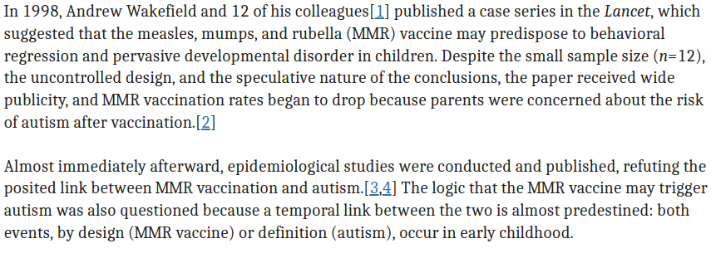
More problems with observational studies
2. RCTs, the golden standard

Slide 23
Causal Inference in your field?
Basic framework
Take a look at the few Causal Inference questions in your field that you wrote previously.
When you are comparing different states of the world w.r.t. your questions, are there any potential confounders?

Slide 24
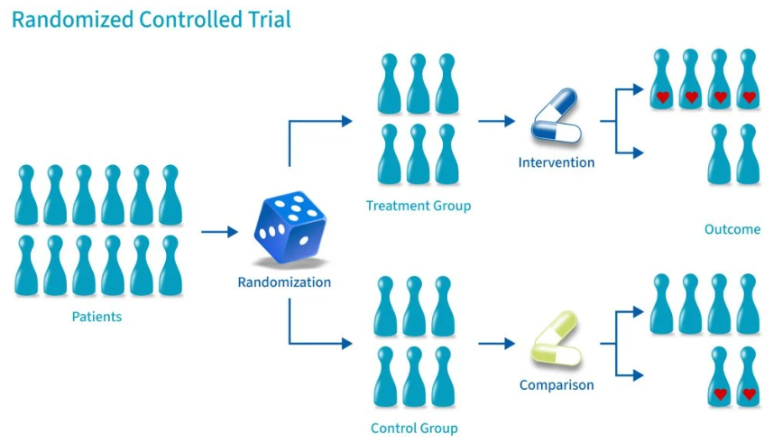
Is there a way out?
Model 1: RCT
2. RCTs, the golden standard
Comparing treated vs untreated = ATE when treatment is independent of potential outcomes
Is there a way to enforce ?
Holds by construction
Model 1 assumption:
Source: Simkus, 2023

Slide 25
Why do we still do observational studies?
2. RCTs, the golden standard
Experiments may not be feasible:
Technologically unfeasible (e.g. impact of Mars’ environment on human health)
Budget constraints (e.g. impact of cleaning the oceans from plastic on wildlife)
Unethical (e.g. testing chemicals on humans such as BPA)
Time constraint (e.g. is pitch a viscous substance? The Physics pitch drop experiment, since 1927)
Not possible to enforce randomness (e.g. running/studying plan on performance)
Observational studies can still give some hints of mechanisms, but we have to be open about potential biases.
Next: Other models are still able to estimate treatment effects cleanly with observational data, given that their assumptions are satisfied.

Slide 26
Causal Inference in your field?
Basic framework
Take a look at the few Causal Inference questions in your field that you wrote previously.
Maybe randomization is the only way to answer your questions
Try to think if the next models could also be suited to answer your causal questions

Slide 27
Outline
Basic framework
Motivation
Potential Outcomes
(some) Parameters of interest
The golden standard: Randomized Experiments (RCT)
When randomization isn’t an option
Selection on observables
Matching
Regression Discontinuity Design (RD)
Instrumental Variables (IV)
Panel Data and Fixed Effects
Difference-in-differences (DiD)
Synthetic Control
Machine learning and Causal Inference
Aiding the development of new theories

Slide 28
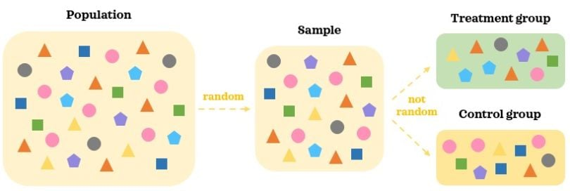
Model 2: Selection on Observables
3. When randomization isn’t an option

Slide 29
Model 2: Selection on Observables
3. When randomization isn’t an option
If not from an RCT, it is extremely rare that: .
An observational sample often is skewed towards certain populations defined by observable characteristics (Xi), that are, in turn correlated with potential outcomes:
E.g. women can have different potential outcomes Y(0) and Y(1) than men w.r.t. a medication. Imbalances in the sample w.r.t. gender can therefore bias estimates of average treatment effects
In order to tackle the imbalance bias, we can re-weight our sample.

Slide 30
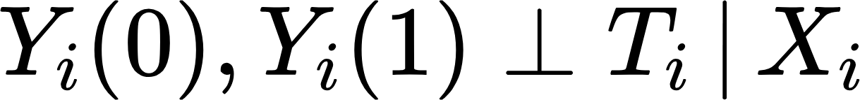
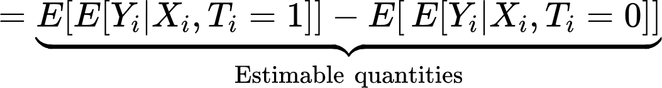
Model 2: Selection on Observables
3. When randomization isn’t an option
If not from an RCT, it is extremely rare that: .
It is also not common, but more plausible that:
‘Selection on obs.’ or ‘Ignorability’ or ‘Conditional Independence’
Model 2 assumptions:
Dummy for gender female
i | Ti | Yi | Yi(1) | Yi(0) | Xi
Edith | 1 | 10 | 10 | . | 1
Mary | 1 | 7 | 7 | . | 1
John | 0 | 5 | . | 5 | 0
James | 1 | 8 | 8 | . | 0
Elyse | 0 | 4 | . | 4 | 1
Common support
Identification:
by the Law of Iterated Expectations
by Model 1 Assumption
Expectations often assumed to be linear on functions of X and T, so we could use linear regression to estimate them

Slide 31
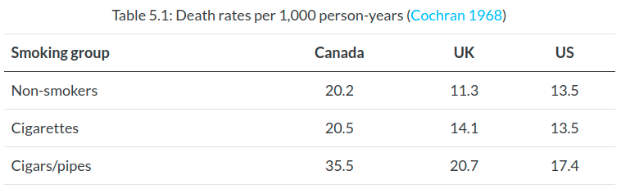
Model 2: Selection on Observables
3. When randomization isn’t an option
A simple, but important example: back to the cigarettes

Slide 32
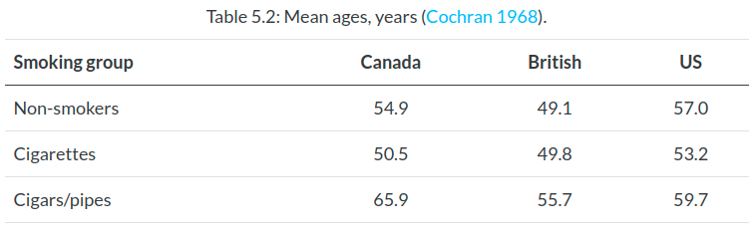
Model 2: Selection on Observables
3. When randomization isn’t an option
A simple, but important example: back to the cigarettes

Slide 33
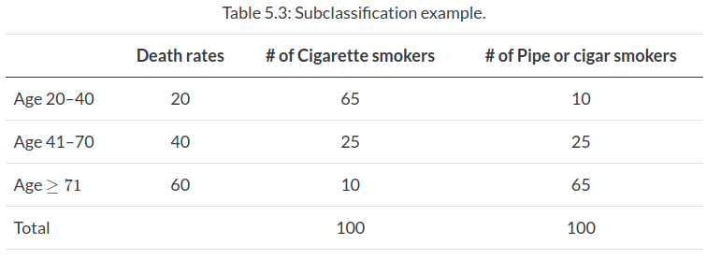
Model 2: Selection on Observables
3. When randomization isn’t an option
A simple, but important example: back to the cigarettes

Slide 34
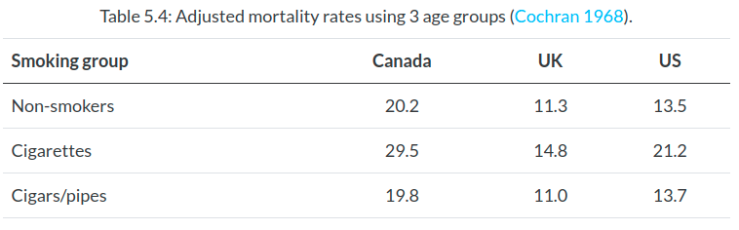
Model 2: Selection on Observables
3. When randomization isn’t an option
A simple, but important example: back to the cigarettes

Slide 35
Model 2: Selection on Observables
3. When randomization isn’t an option
Even if Model Assumption 1 doesn’t fully hold, computing treatment effects by conditioning on Xi, when Xi explains Yi:
often alleviates potential omitted variable bias
reduces overall standard error estimates
Model 2 assumptions:

Slide 36
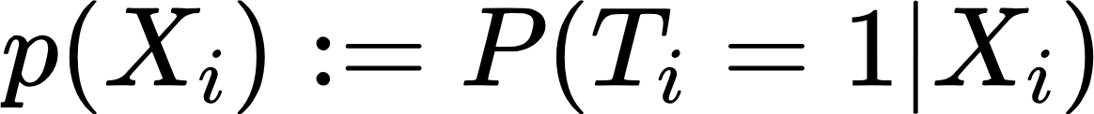
Model 3: Matching
3. When randomization isn’t an option
Matching is another form of estimating treatment effects under the selection on observables set up.
Treatment and Control observations are usually paired/compared only with observations that are similar w.r.t. their X values, then treatment effects can be computed “locally” on X and later averaged.
Types of matching techniques:
Exact matching
Coarsened matching
Nearest neighbor matching
Propensity score matching:

Slide 37
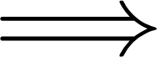
Model 3: Matching
3. When randomization isn’t an option
The assumptions are still the same, but the propensity score makes it easier to check the common support assumption, especially when X is high-dimensional
Model 3 assumptions:
Model 3 assumptions:

Slide 38
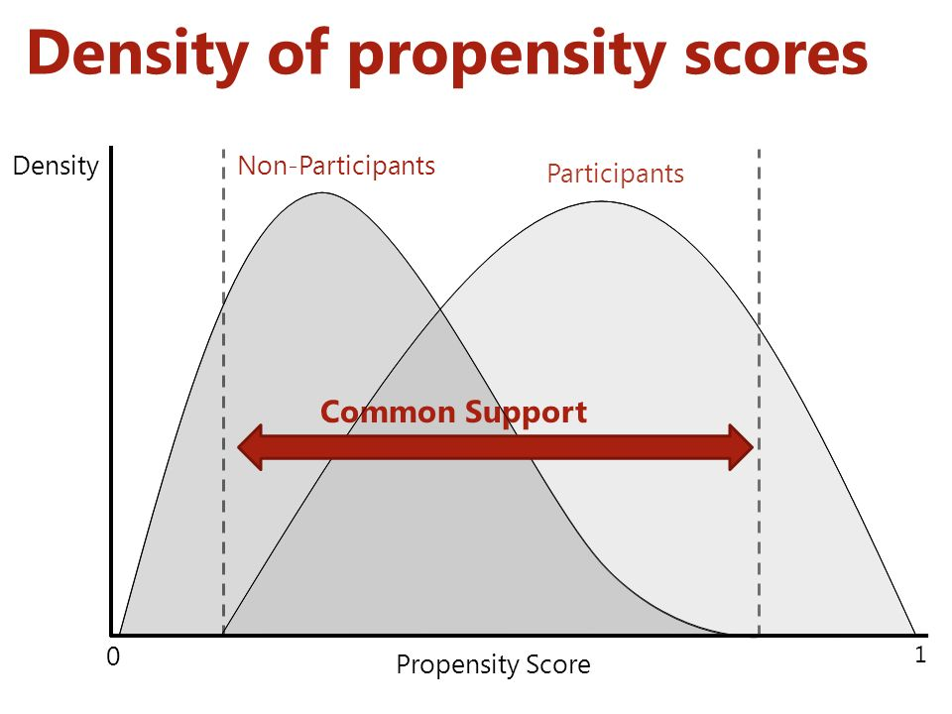
Model 3: Matching
3. When randomization isn’t an option
Checking the common supports assumption and trimming non-comparable observations (but be careful not to bias your ATE!)

Slide 39
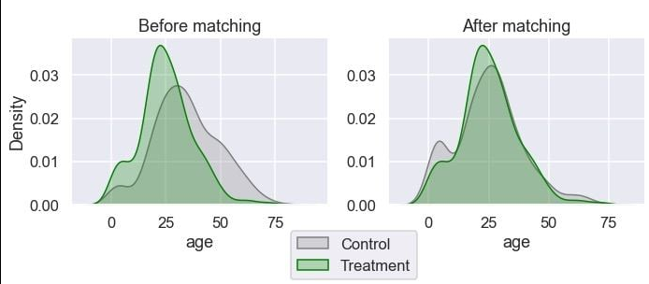
Model 3: Matching
3. When randomization isn’t an option
Another way to operationalize matching treatment effects consists in reweighting the data with propensity scores, so control and treatment look similar w.r.t. their covariates X (as if treatment was random):

Slide 40
Model 4: Regression Discontinuity (RD)
3. When randomization isn’t an option
Exogenous discontinuities that impact the chance of being treated exist in the world:
Education: admission threshold test scores
Healthcare Interventions: health score thresholds for treatment
Environmental Regulations: emission thresholds.
Economic Policies: Unemployment benefit at eligibility cutoffs.
Social Programs: Welfare program based on income cutoffs

Slide 41
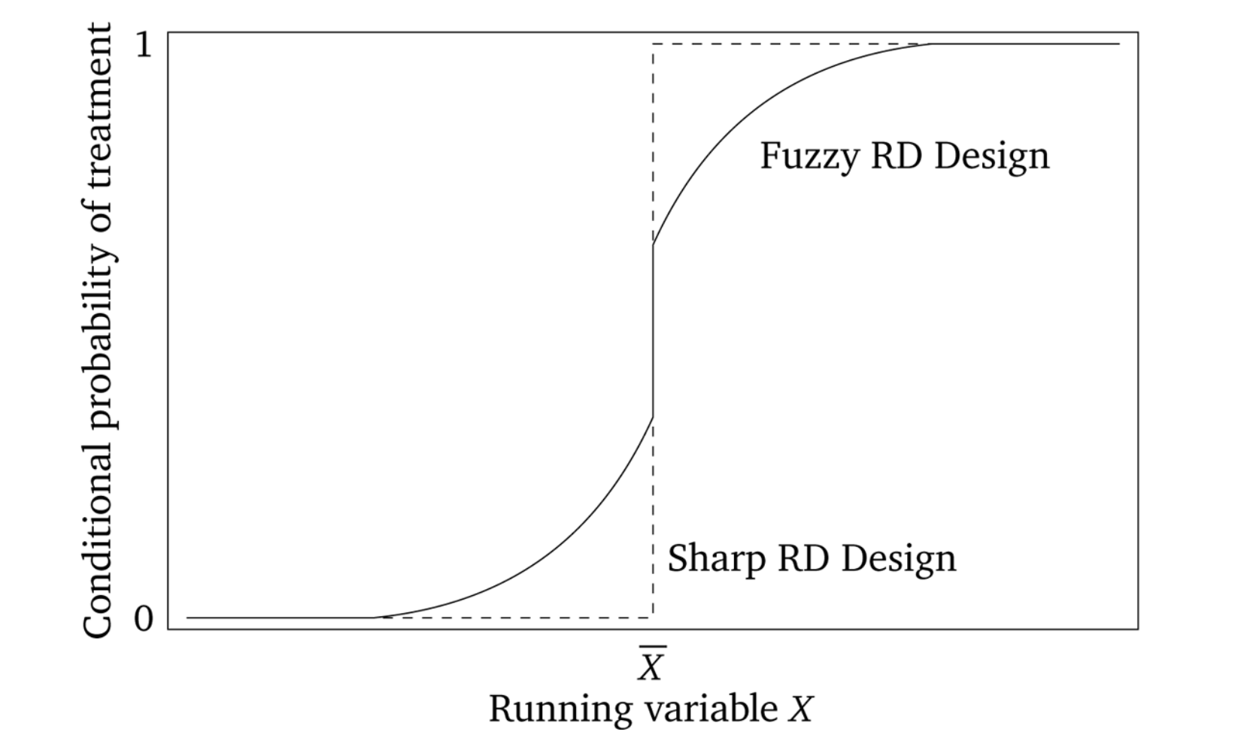
Model 4: Regression Discontinuity (RD)
3. When randomization isn’t an option
Exogenous discontinuities that impact the chance of being treated:
Model 4 assumptions:
Exogenous cutoff
Discontinuity in the treatment density around the cutoff
NOTE: It is good to check that there aren’t discontinuities in the densities of X around the cutoff

Slide 42
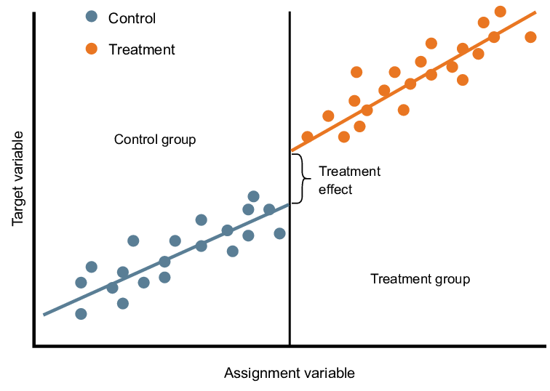
Model 4: Regression Discontinuity (RD)
3. When randomization isn’t an option
Sharp RD

Slide 43
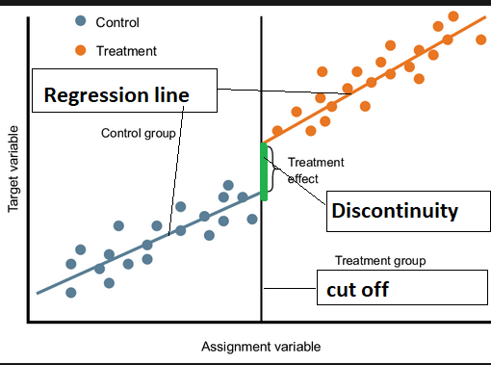
Model 4: Regression Discontinuity (RD)
3. When randomization isn’t an option
Sharp RD
NOTE 1: Common support assumption not satisfied by construction!
NOTE 2: What kind of treatment effect are we estimating? Can we extrapolate?

Slide 44
Model 4: Regression Discontinuity (RD)
3. When randomization isn’t an option
Potential problems that we will touch base with our hands-on section:
Manipulation at the threshold (McCrary test)
Observations far from the cutoff influencing the regression at the cut off
If Fuzzy RD, what to do?
Re-weighting technique to estimate the Local Average Treatment Effect (LATE), identical to the Instrumental Variables estimation (our next model).

Slide 45
Model 5: Instrumental Variables (IV)
3. When randomization isn’t an option
Remember RD? IV has similarities to it
Instrumental Variable Design
Model 5 assumptions:
Z causes Y only through T
Exogenous instrument
Excluded instrument
Monotonicity of propensity score on Z
/ Instrument Z

Slide 46
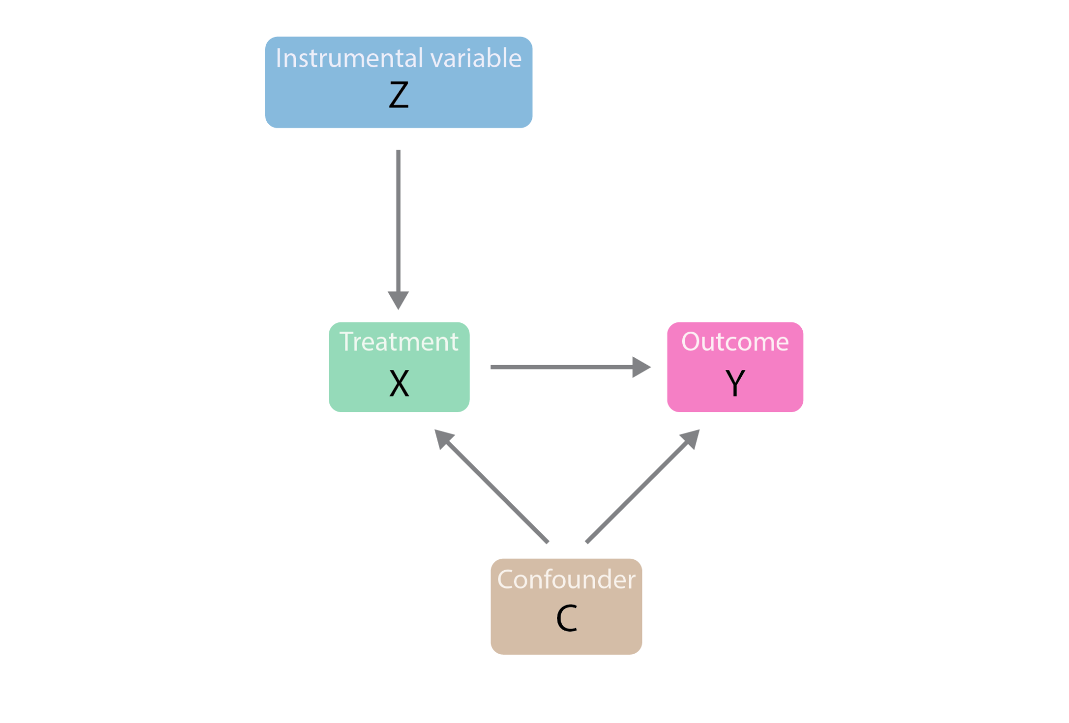
Model 5: Instrumental Variables (IV)
3. When randomization isn’t an option
Model 5 assumptions:
Z causes Y only through T
Exogenous instrument
Excluded instrument
Monotonicity of propensity score on Z

Slide 47
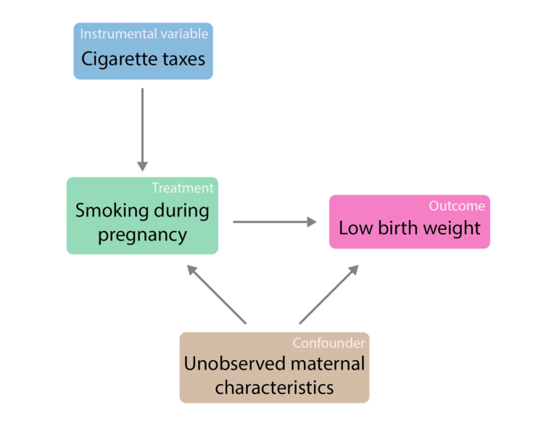
Model 5: Instrumental Variables (IV)
3. When randomization isn’t an option
Model 5 assumptions:
Z causes Y only through T
Exogenous instrument
Excluded instrument
Monotonicity of propensity score on Z

Slide 48

Model 5: Instrumental Variables (IV)
3. When randomization isn’t an option
For simplicity, consider a binary instrument Z
IV subpopulations and no-defiance assumption

Slide 49
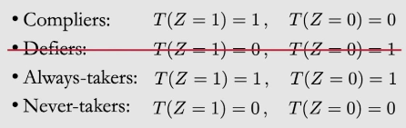
Model 5: Instrumental Variables (IV)
3. When randomization isn’t an option
For simplicity, consider a binary instrument Z
IV subpopulations and no-defiance assumption

Slide 50
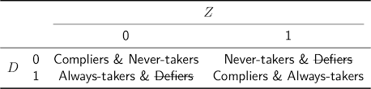
Model 5: Instrumental Variables (IV)
3. When randomization isn’t an option
For simplicity, consider a binary instrument Z
IV subpopulations and no-defiance assumption
T

Slide 51
Model 5: Instrumental Variables (IV)
3. When randomization isn’t an option
Remember RD? IV has similarities to it
Instrumental Variable Design
Local Average Treatment Effects (LATE)
Effect only on compliers
/ Instrument Z

Slide 52

Model 5: Instrumental Variables (IV)
3. When randomization isn’t an option
How economists feel about IV:
Model 5 assumptions:
Z causes Y only through T
Exogenous instrument
Excluded instrument
Monotonicity of propensity score on Z

Slide 53
Model 6: Panel data & Fixed Effects
3. When randomization isn’t an option
Panel/longitudinal data:
Same observation unit observed over time
Panels are very informative about unit specific traits that affect Y, even though we aren’t aware of them
Conditioning on unit Fixed Effects allow us to remove confounders/omitted variables that do not vary over time
Estimation
Analogous to including a dummy per unit in a regression
We need to cluster standard errors per unit for inference

Slide 54
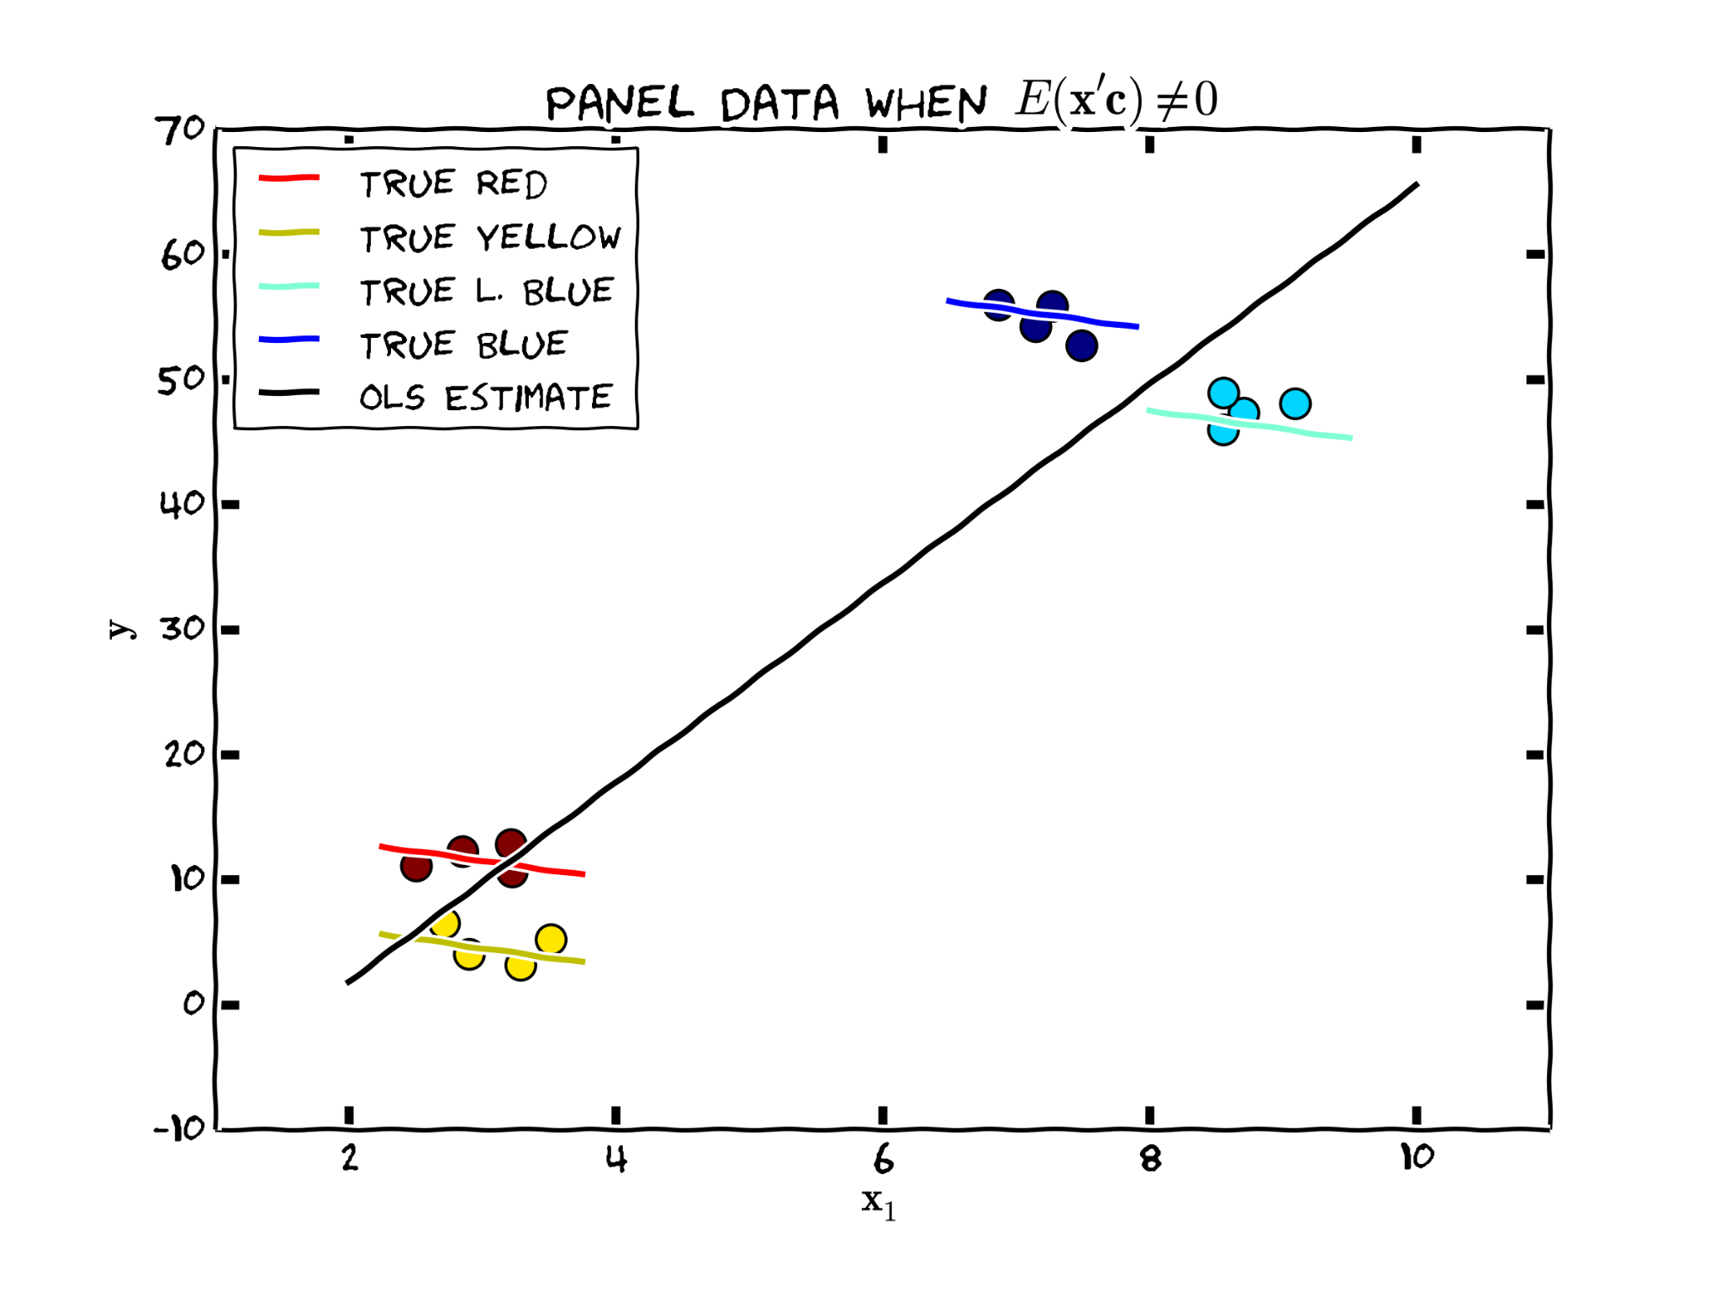
Model 6: Panel data & Fixed Effects
3. When randomization isn’t an option
Model 6 assumptions:
Still assuming selection on observables assumptions, but it just allows for tighter controls

Slide 55
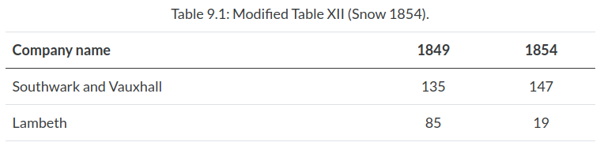
Model 7: Difference-in-Differences (DiD)
3. When randomization isn’t an option
John Snow & Cholera (1954)
Cholera was thought to be transmitted by stale air (miasma)
Water companies providing contaminated water from Thames
Lambeth Water company in 1949 moved its intake pipes upstream higher up the Thames river (exogenous shock), while the other companies kept their intake pipes as usual. Average deaths by Cholera:

Slide 56
Model 7: Difference-in-Differences (DiD)
3. When randomization isn’t an option
John Snow & Cholera (1954)
If households served by the different water companies are similar
The difference of the differences is an Average Treatment Effect:
(19-85) - (147-135) = -78 deaths/10,000 households

Slide 57
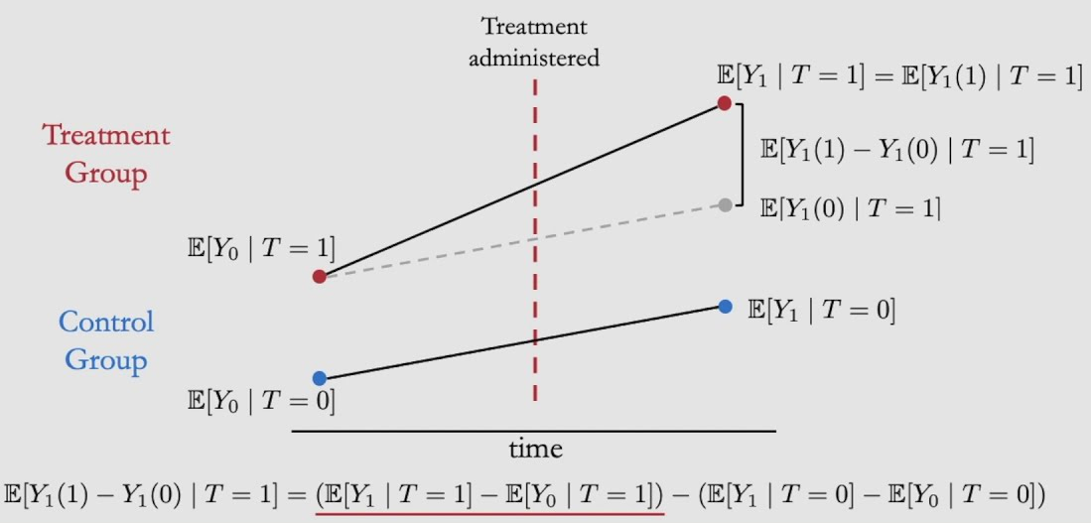
Model 7: Difference-in-Differences (DiD)
3. When randomization isn’t an option
Model 7 assumptions:
Exogenous shock
Parallel trends

Slide 58
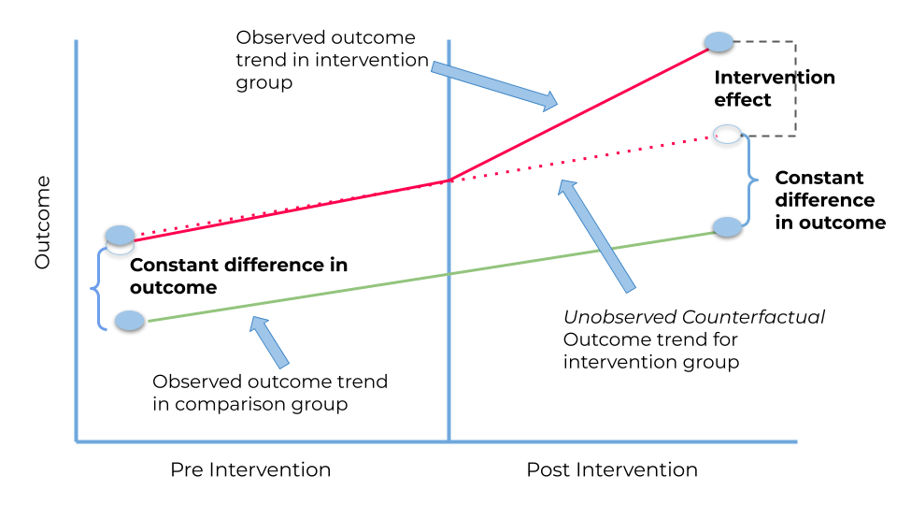
Model 7: Difference-in-Differences (DiD)
3. When randomization isn’t an option
NOTE: Make the parallel trends assumption more credible by showing pre-treament parallel trends evidence
Model 7 assumptions:
Exogenous shock
Parallel trends

Slide 59
Model 8: Synthetic Control
3. When randomization isn’t an option
When trends aren’t parallel pre-treatment, synthetic control! Idea:
Choose weights to combine multiple control units into a synthetic unit that behaves like the treatment unit pre-treatment
Inference helps to make it more credible too:
We will see placebo exact tests in our hands-on section.
Model 8 assumptions (same as DID):
Exogenous shock
Parallel trends

Slide 60
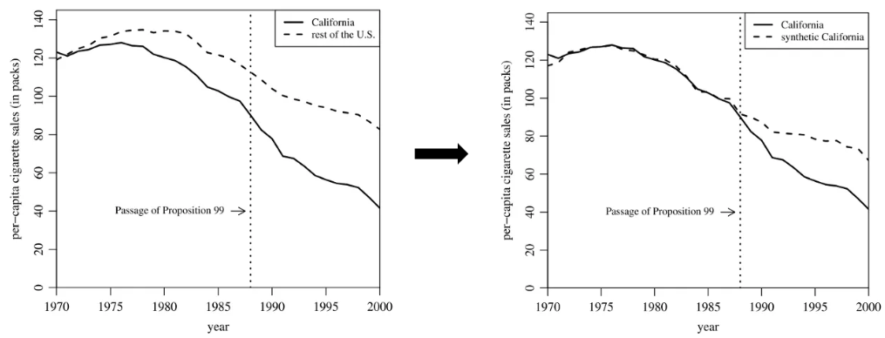
Model 8: Synthetic Control
3. When randomization isn’t an option

Slide 61
Hands-on section
Google colab: bit.ly/44RzPkp
We will analyze Causal Inference estimators under
different scenarios using Python in Google Colab

Slide 62
Outline
Basic framework
Motivation
Potential Outcomes
(some) Parameters of interest
The golden standard: Randomized Experiments (RCT)
When randomization isn’t an option
Selection on observables
Matching
Regression Discontinuity Design (RD)
Instrumental Variables (IV)
Panel Data and Fixed Effects
Difference-in-differences (DiD)
Synthetic Control
Machine learning and Causal Inference
Aiding the development of new theories

Slide 63
ML and CI guiding the development of theory
4. Machine Learning & Causal Inference
Machine Learning models are famous for being extremely flexible:
Models are able to capture nonlinear structures and complex interactions between variables
This feature often allows us to uncover patterns that may not be fully covered by existing theory
However, some of the captured patterns can be due to pure randomness in the data, not necessarily reflecting a structural truth about the world
Machine Learning, in conjunction with Explainable AI, can uncover these potentially interesting patterns in the data
Causal Inference can help testing whether these patterns reflect a causal path
We will see an example of this ML + CI combination in the next slides

Slide 64
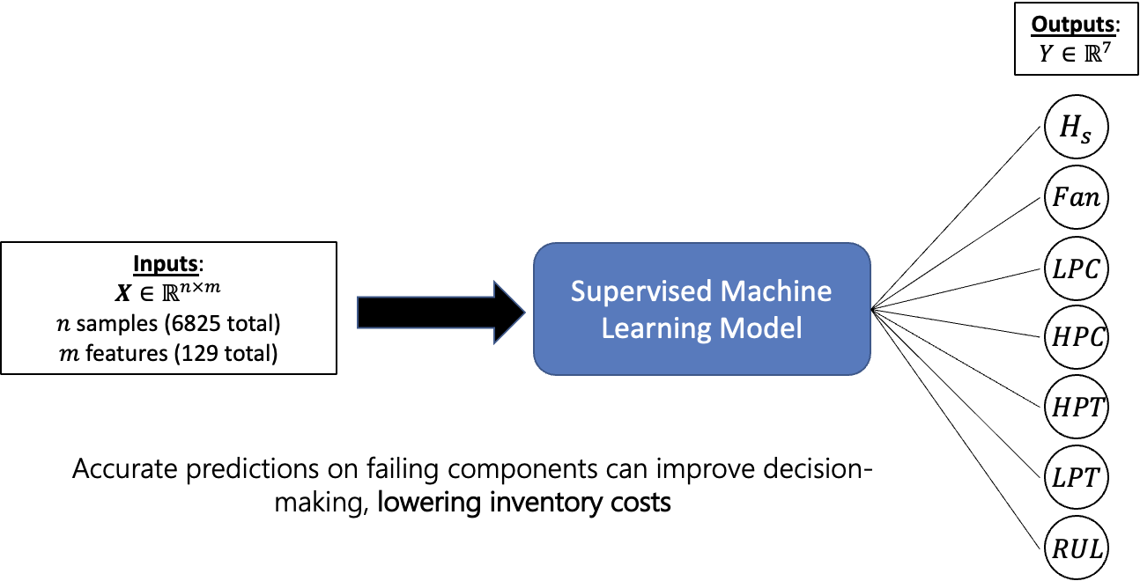
ML and CI guiding the development of theory
1) Industrial AI: Actionable Predictions
4. Machine Learning & Causal Inference
How can we simultaneously predict the remaining useful life and failure mode in real time?
Current Health State
Real-time sensor measurements
Forecasting Potential Failing Component(s)
Remaining Useful Life
Notes:
Supervised ML here is a black box model, makes actionable predictions. 2 layers, 10000 parameters Outputs
Hs = normal or abnormal (binary)
Fan - LPT (6 engine components) = will this component fail (in the engines remaining life) (binary)
RUL = remaining useful life (real number)
Component names
LPC, HPC = low pressure compressor, high pressure compressor
LPT, HPT = low pressure turbine, high pressure turbine

Slide 65
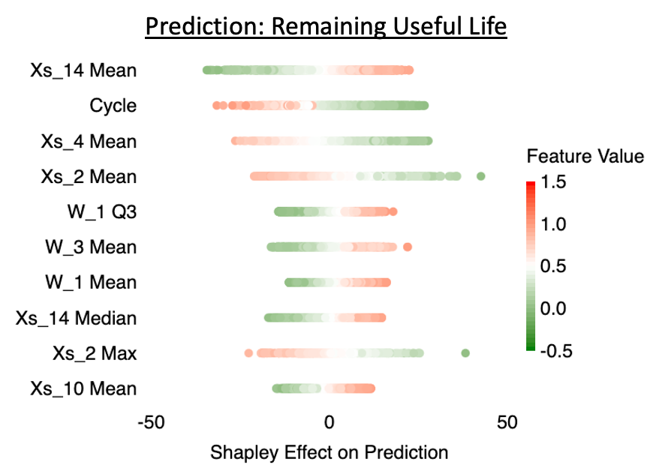
ML and CI guiding the development of theory
2a) Explaining “Why?” (XAI)
4. Machine Learning & Causal Inference
What features contribute most to model outcomes?
Shapley Explainability: Estimating individual feature impacts on predictions
Variable Description
Xs_14 Total pressure at LPT outlet
Cycle Current cycle number
Xs_4 Total temp. at LPC outlet
Xs_2 Physical fan speed
W_1 Altitude
W_3 Throttle-resolver angle
Xs_10 Total pressure at fan outlet
(cycles)
Notes:
Roadmap
Using approximate Shapley values we quantify the individual feature impacts on predictions
Which is a model agnostic tool (can be applied to any model)
Intuitively the number of engine cycles (odometer) would be the most important feature
However, the analysis shows that total pressure at low pressure turbine is the dominant feature
The plot on the right shows the mean effect of each feature on the remaining useful life prediction, sorted by biggest impact on RUL
But, how certain are we in these feature effects on the prediction?
What level of depth to include on how Shapley is done? Shapley method: Monte carlo sampling method to get marginal contributions (Andreas wrote this, its probably inaccurate)

Slide 66
ML and CI guiding the development of theory
2b) Quantifying “Why?” (UQ)
4. Machine Learning & Causal Inference
How (un)certain are we of our model explanations?
Uncertainty Quantification (UQ) of Shapley Values: Quantifying explanation uncertainty
Previous analysis is based on approximate Shapley estimates
Shapley values are infeasible to compute (2^{m} estimations)
Monte Carlo Shapley estimates are a random approximation
Utilize additivity property of Shapley values
Quantifying uncertainty introduces transparency and the degree of trustworthiness of our model
Notes:
Plot is for one sample! → for this sample Xs_14 Q3 (3rd quartile) is more significant than cycles and Xs_4 mean
m is the number of features (2^m)

Slide 67
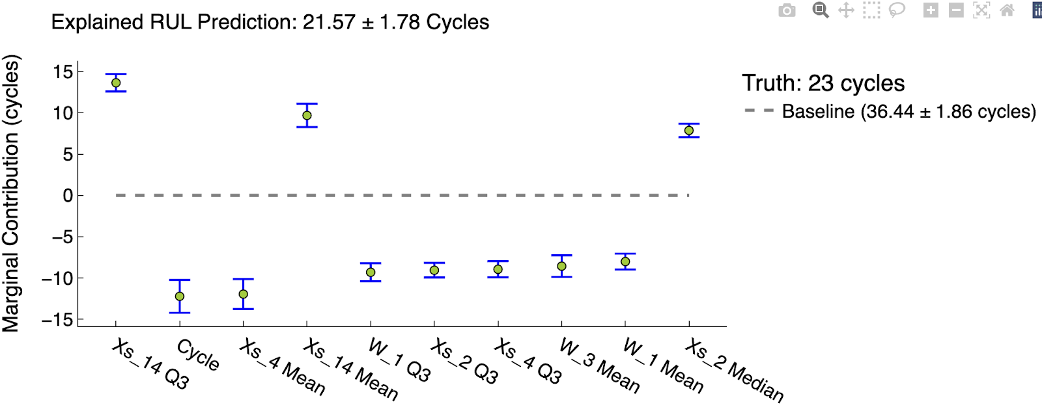
ML and CI guiding the development of theory
2b) Quantifying “Why?” (UQ)
4. Machine Learning & Causal Inference
How (un)certain are we of our model explanations?
“Personalized Prediction Recipes”
Explained RUL Prediction: 21.57 ± 1.78 Cycles
Variable Description
Xs_14 Total pressure at LPT outlet
Cycle Current cycle number
Xs_4 Total temp. at LPC outlet
Xs_2 Physical fan speed
W_1 Altitude
W_3 Throttle-resolver angle
Xs_10 Total pressure at fan outlet
Notes:
Plot is for one sample! → for this sample Xs_14 Q3 (3rd quartile) is more significant than cycles and Xs_4 mean

Slide 68
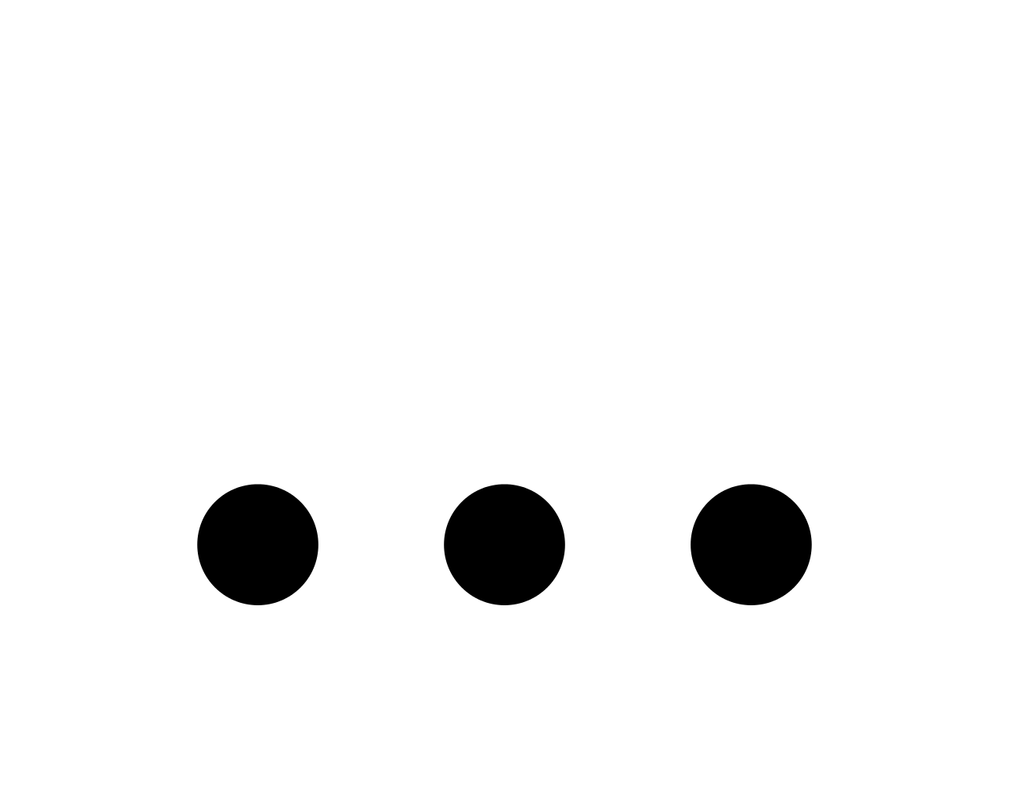
ML and CI guiding the development of theory
3) Prognostics and Causal Inference (CI)
4. Machine Learning & Causal Inference
What causes unexpected engine failures, and what are best mitigation strategies (treatment effects)?
Hypothesis 1
Hypothesis 2
Hypothesis 3
Hypothesis n
MIDAS carpentry multidisciplinary framework has enabled:
Synergy between distinct machine learning domains (Industrial AI + XAI + UQ + CI)
Working together on high-impact applications in science & engineering
Combining disciplines in efforts to develop transparent, trustworthy, and responsible AI

Slide 69
References & study material
For a broad audience (less technical)
PEARL, MACKENZIE (2018) The Book of Why
Foundational books and papers
PEARL (2009) Causality (http://bayes.cs.ucla.edu/BOOK-2K/)
*IMBENS; WOOLDRIDGE (2009) Recent Developments in the Econometrics of Program Evaluation
PEARL (2010) An Introduction to Causal Inference
IMBENS; RUBIN (2015) Causal Inference in Statistics, Social and Biomedical Sciences: An Introduction
Current Causal Inference textbooks
*ANGRIST (2008) Mostly Harmless Econometrics
*MORGAN, WINSHIP (2015) Counterfactuals and Causal Inference
*CUNNINGHAM (2021) Causal Inference: The Mixtape (https://mixtape.scunning.com/)
HERNAN; ROBINS (2023) Causal Inference: What if? (https://www.hsph.harvard.edu/miguel-hernan/causal-inference-book/)
*ALVES (2023) Causal Inference for the Brave and True (https://matheusfacure.github.io/python-causality-handbook/landing-page.html)
Causal Inference and Machine Learning
PETERS et al. (2017) Elements of Causal Inference: Foundation and Learning Algorithms
* These were the most influential references to prepare this material.

Slide 70

Thanks for coming!

